Slide 1
Heap
Course Code: CSC 2106
Course Title: Data Structure (Theory)
Dept. of Computer Science
Faculty of Science and Technology
Lecture No: | 10.2 | Week No: | 10 | Semester: | Fall 2020-2021
Lecturer: | MAHFUJUR RAHMAN, mahfuj@aiub.edu

Slide 2
Lecture Outline
Heap
Heap Types
Heap as an Array
Array Representation of Max Heaps
Operations on Heap

Slide 3
Heap
A heap is a binary tree with the following conditions:
It is essentially complete: all its levels are full, except last level where only some rightmost leaves may be missing
The key at each node is ≥ keys at its children

Slide 4
Heap
Def: A heap is a complete binary tree with the following two properties:
Structural property: all levels are full, except possibly the last one, which is filled from left to right
Order (heap) property: for any node x
Parent(x) ≥ x
8
It doesn‘t matter that 4 in level 1 is smaller than 5 in level 2
7
4
5
2
Heap (top to bottom and left to right)

Slide 5
Heap Example
A heap
Not a heap
Not a heap
Note: Heap’s elements are ordered top down (along any path down from its root), but they are not ordered from left to right

Slide 6
Heap Types
Max-heaps (largest element at root), have the max-heap property:
for all nodes, excluding the root:
PARENT ≥ child
Min-heaps (smallest element at root), have the min-heap property:
for all nodes , excluding the root:
PARENT ≤ child

Slide 7
Heap Types (Example)
7
1
5
5
2
5
4
2
4
3
4
5
6
7
Max-heaps
Min-heaps

Slide 8
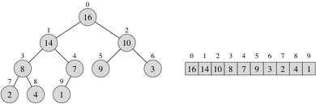
Heap as an array
Parent left Child right Child
index index index
i 2i+1 2i+2
⎣(i-1)/2⎦ i

Slide 9
Array Representation of Max Heaps
A heap is a complete binary tree that is filled in order
When index i is from 0 to n-1 and number of element = length of A[]= n and n= 10
Root of tree is A[0] = 16
Left child of A[i] = A[2i+1]
Right child of A[i] = A[2i + 2]
Parent of A[i] = A[ ⎣(i-1)/2⎦ ]
Heapsize[A] ≤ length[A]
0
16
1
2
14
10
3
4
5
6
8
7
9
3
7
8
9
2
4
1

Slide 10
Array Representation of Max Heaps
0
The elements in A[⎣n/2⎦]…..A[n-1] are leaves
i.e. A[5] to A[9]
Parents are A[0]………..A[⎣n/2⎦-1]
i.e. A[0] to A[4]
The root have the maximum element of the heap
i.e. A[0]=16
16
1
2
14
10
3
4
5
6
8
7
9
3
7
8
9
2
4
1

Slide 11
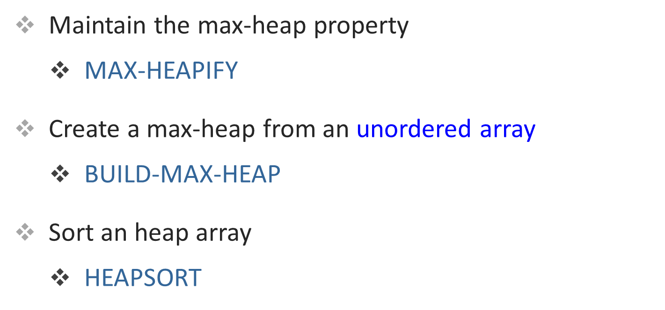
Operations on Heaps

Slide 12
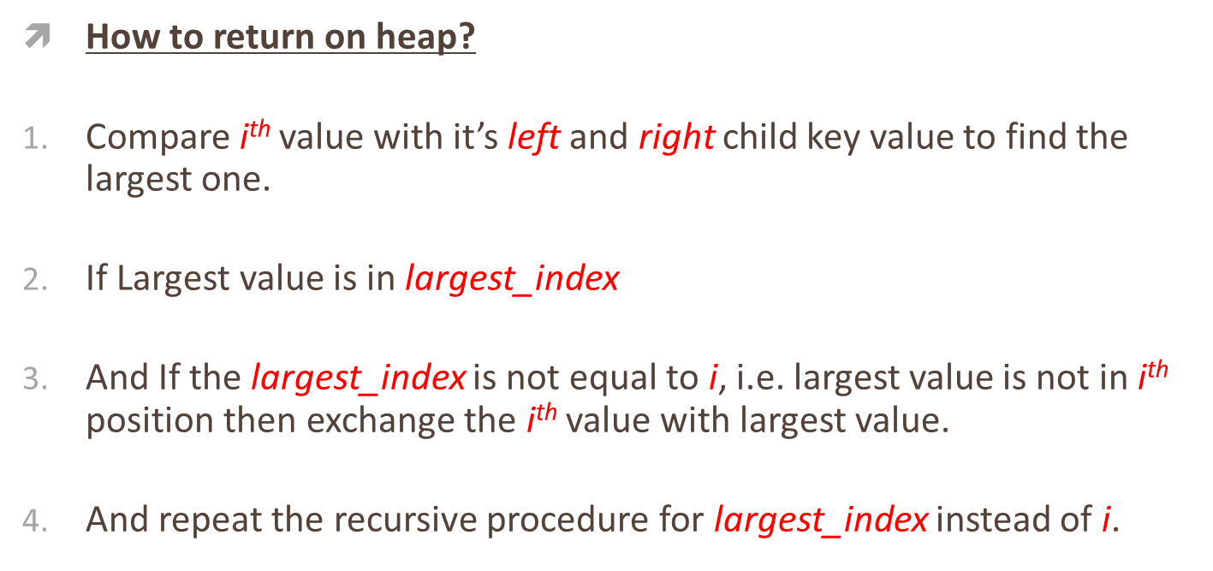
Maintaining the Heap Property

Slide 13
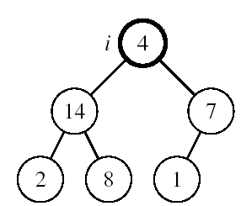
Maintaining the Heap Property
When:
Left and Right subtrees of i are max-heaps and
A[i] breaks the heap property.
A[i] may be smaller than its children

Slide 14
MAX-HEAPIFY(A, i, n)
LEFT_child = 2i+1
RIGHT_child =2i+2
If LEFT_child < n and A[LEFT_child] > A[i]
then largest_index = LEFT_child
else largest_index = i
If RIGHT_child < n and A[RIGHT_child] > A[largest_index]
then largest_index = RIGHT_child
if largest_index ≠i
then exchange A[i] ↔ A[largest_index]
MAX-HEAPIFY(A, largest_index, n)

Slide 15
Initializing A Max Heap
4
14
7
2
8
1
Find the position (home) for 4.

Slide 16
Initializing A Max Heap
14
4
7
2
8
1
Again find the position (home) for 4.

Slide 17
Initializing A Max Heap
14
8
7
2
4
1
Done

Slide 18
Building a Heap
Convert an array A[0…n-1] into a max-heap
when,
n = length of A[] = number of element
The elements in the sub-array A[⎣n/2⎦] …… A[n-1] are leaves
Apply MAX-HEAPIFY on elements among A[(⎣n/2⎦-1)] to A[0]
0
4
1
2
1
3
3
4
5
6
2
16
9
10
7
8
9
14
8
7
A:
4 | 1 | 3 | 2 | 16 | 9 | 10 | 14 | 8 | 7

Slide 19
Building a Heap
Alg: BUILD-MAX-HEAP(A)
n = length of A[]
for i = ⎣n/2⎦-1 down to 0
do MAX-HEAPIFY(A, i, n)
0
4
1
2
1
3
3
4
5
6
2
16
9
10
7
8
9
14
8
7
A:
4 | 1 | 3 | 2 | 16 | 9 | 10 | 14 | 8 | 7

Slide 20
Building A Max Heap
1
2
3
4
5
6
7
8
9
7
11
7
8
10
input array = [1, 2, 3, 4, 5, 6, 7, 8, 9, 10, 11] and n=11

Slide 21
Building A Max Heap
1
2
3
4
5
6
7
8
9
7
11
7
8
10
Start at rightmost node that has a child i.e. last parent
Index is (⎣n/2⎦-1)

Slide 22
Building A Max Heap
1
2
3
4
11
6
7
8
9
7
5
7
8
10
Move to next lower array position. Repeat it up to root.

Slide 23
Building A Max Heap
1
2
3
4
11
6
7
8
9
7
5
7
8
10
Find home for 4.

Slide 24
Building A Max Heap
1
2
3
9
11
6
7
8
4
7
5
7
8
10
Done, move to next lower array position.

Slide 25
Building A Max Heap
1
2
3
9
11
6
7
8
4
7
5
7
8
10
Find home for 3.

Slide 26
Building A Max Heap
1
2
7
9
11
6
3
8
4
7
5
7
8
10
Done, move to next lower array position.

Slide 27
Building A Max Heap
1
2
7
9
11
6
3
8
4
7
5
7
8
10
Find a home for 2.

Slide 28
Building A Max Heap
1
11
7
9
2
6
3
8
4
7
5
7
8
10
Find a home for 2.

Slide 29
Building A Max Heap
1
11
7
9
10
6
3
8
4
8
7
2
7
5
Done, move to next lower array position.

Slide 30
Building A Max Heap
1
11
7
9
10
6
3
8
4
2
7
7
8
5
Find home for 1.

Slide 31
Building A Max Heap
11
1
7
9
10
6
3
8
4
2
7
7
8
5
Find home for 1.

Slide 32
Building A Max Heap
11
10
7
9
1
6
3
8
4
2
7
7
8
5
Find home for 1.

Slide 33
Building A Max Heap
11
10
7
9
5
6
3
8
4
2
7
7
8
1
Done

Slide 34
Exercise
Arrange this array as a heap tree/Array?
Input Array
Output Array/
Heap Array
5 | 4 | 9 | 7 | 19 | 8 | 17 | 2 | 6 | 5 | 21
21 | 19 | 17 | 7 | 5 | 8 | 9 | 2 | 6 | 5 | 4

Slide 35
Exercise
1. Arrange this array as a heap tree/Array?
0
5
1
2
4
9
3
4
5
6
7
19
8
17
7
8
9
2
6
5
21

Slide 36
Books
“Schaum's Outline of Data Structures with C++”. By John R. Hubbard (Can be found in university Library)
“Data Structures and Program Design”, Robert L. Kruse, 3rd Edition, 1996.
“Data structures, algorithms and performance”, D. Wood, Addison-Wesley, 1993
“Advanced Data Structures”, Peter Brass, Cambridge University Press, 2008
“Data Structures and Algorithm Analysis”, Edition 3.2 (C++ Version), Clifford A. Shaffer, Virginia Tech, Blacksburg, VA 24061 January 2, 2012
“C++ Data Structures”, Nell Dale and David Teague, Jones and Bartlett Publishers, 2001.
“Data Structures and Algorithms with Object-Oriented Design Patterns in C++”, Bruno R. Preiss,

Slide 37
References
https://en.wikipedia.org/wiki/Data_structure

